Slide 1

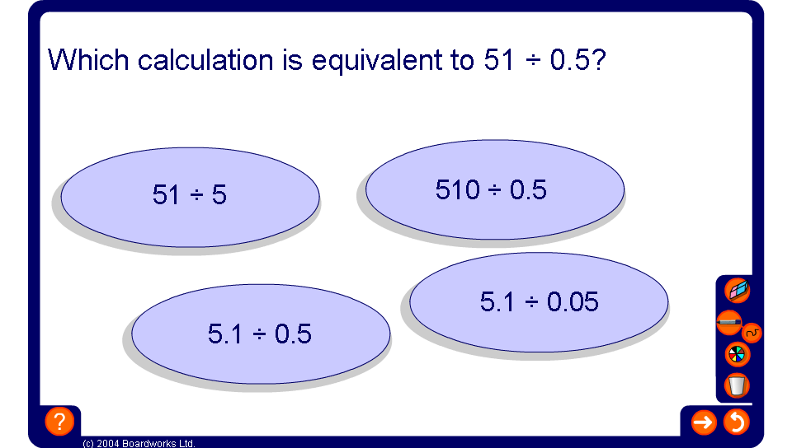


Find the equivalent calculation
Notes:
Establish that when dividing an equivalent calculation can be made by multiplying both the dividend and the divisor by the same number (or dividing both the dividend and the divisor by the same number).

